Slide 1


Research Data Services
Harvard DataFest, January 19, 2021
Mercè Crosas, Ph.D., Harvard University
University Research Data Management Officer, HUIT
Chief Data Science and Technology Officer, IQSS scholar.harvard.edu/mercecrosas @mercecrosas

Slide 2
A Recent US Report

Slide 3
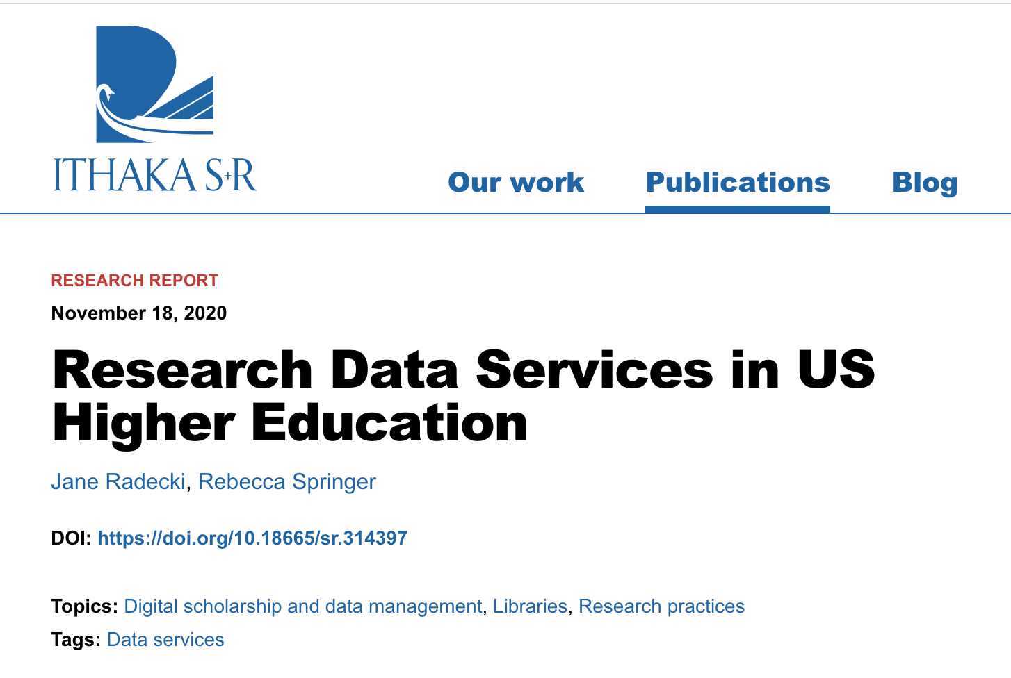
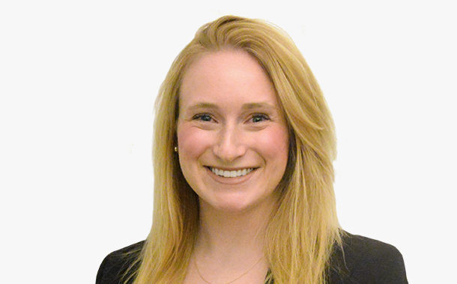
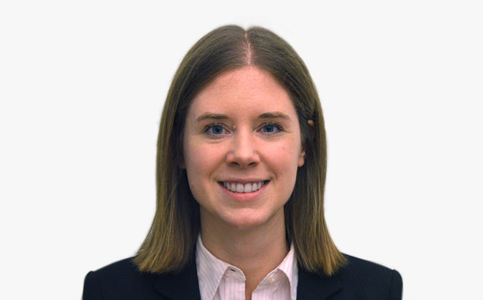
Jane Radecki
Rebecca Springer

Slide 4
Study Design and Definitions
Review 120 US universities
Three groups:
R1: doctoral universities: very high research activity (e.g. Harvard)
R2: doctoral universities: high research activity
SLACs: Baccalaureate colleges
Consider research data and computing services from:
Libraries
IT/Research Computing
Research center and facilities
Professional Schools (e.g., Medical School, Business School)
“we defined research data services as any concrete, programmatic offering intended to support researchers in working with data.”
Report on Research Data Services in US Higher Education

Slide 5
Key Findings
Libraries are important providers of research data services
IT/research computing provide fewer research data services than libraries, but are also an important provider
A wide variety of services are provided by academic departments, research centers and facilities, and professional schools
High performance computing offered: 100% R1, 60% R2, 24% SLACs
Report on Research Data Services in US Higher Education

Slide 6
Types of Research Data Services
Within Libraries and IT
Consulting
Training events
Backend work (data architecture, metadata design)
Front end work (web development, data visualizations)
Outside Libraries and IT
Statistics
Bioinformatics
Geospatial
Clinical data
Business
Social Science
Visualizations
Report on Research Data Services in US Higher Education
Notes:
Consultoria
Formació, tallers

Slide 7
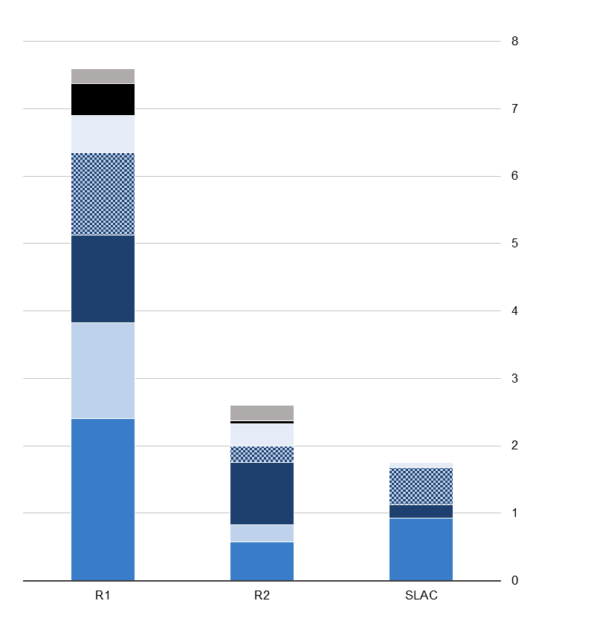
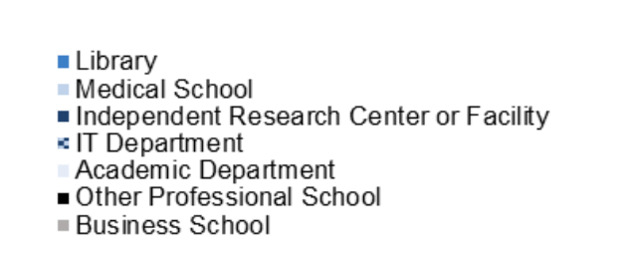
Libraries are the largest contributors to Research Data Services:
32% in R1s
53% in SLACs
Only 22% in R2s

Slide 8
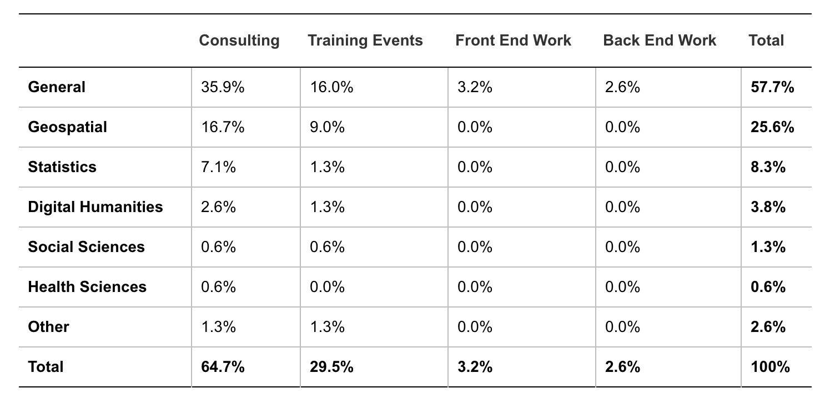
Profile of types of Library Data Services
Generalist consultation is the most common service offered by the libraries

Slide 9
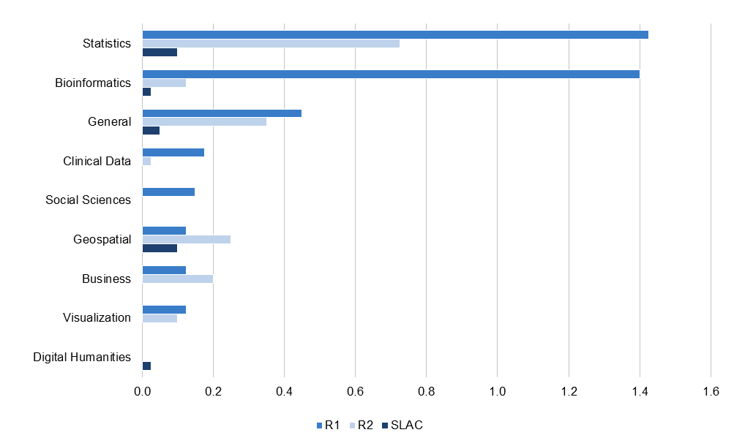
Average number of research data services per institution offered by centers and facilities, departments, and schools

Slide 10
Report Conclusions
Research Data Services in US universities are decentralized and uneven
Data-driven research is increasing, but services not funded at same pace
Should duplicated services merge for efficiency?
Should collaborative models across universities be used to share expertise?
“As centralized points of contact on campus, libraries, IT departments, and research offices may be particularly well positioned to act as dispatchers, connecting scholars to the services that best meet their needs”
Report on Research Data Services in US Higher Education

Slide 11
Our efforts at Harvard

Slide 12
A wide variety of research services across Harvard. Collaboration between Research offices, the Library, and IT is key.
Office of Vice Provost for Research
Institution Data Policies
Research
Data Use Agreements
Sponsored Research,
Funders Data Policies
Review Board
Best Practices
Data Safety Policies
Journals and Funders Data Policies
Library
IT
Security Levels
Data Management Plans
Clouds
Curation
Training
Research computing
Preservation
Repositories
Data Visualizations,
Analytics
Software, Pipelines, Electronic Lab Notebooks, Computational Notebooks

Slide 13
A new inventory of research support services and a single resource to find them
A collaboration on building a research support services catalog and a website with a common vision:
“To help faculty, researchers, and those who work with them to advance their research by easily finding and browsing the University’s breadth of resources and services”
Sponsored by the Library, HUIT, and Office of Vice Provost for Research
Initial launch planned for: Early 2021
Harvard Efforts on Research Support Services

Slide 14
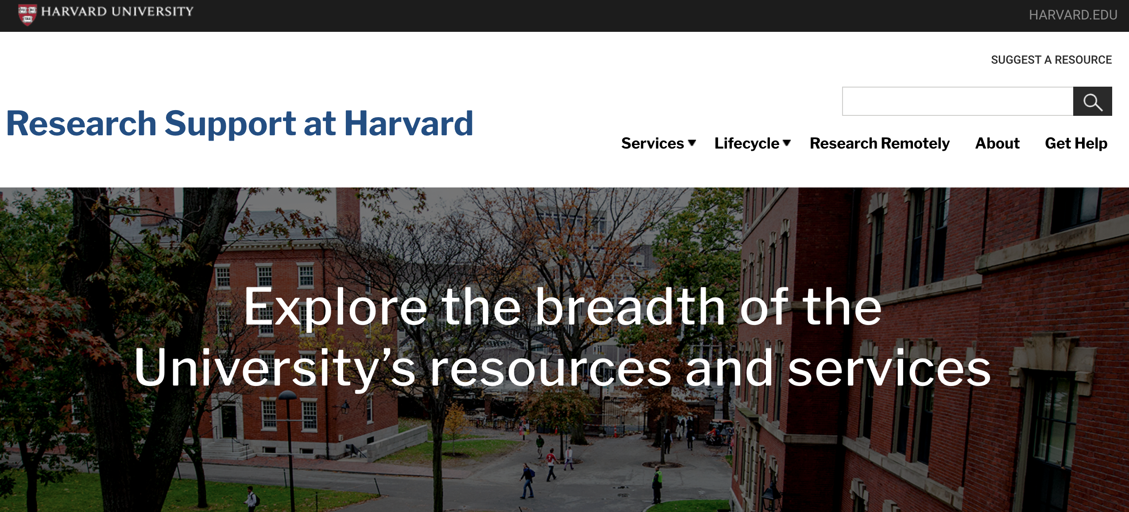
https://researchsupport.harvard.edu/

Slide 15
Build inventories of existing services
Collect data: Phase I, 2018-2020
Harvard Library (11 libraries/units)
Research Computing (4 schools/units)
Research Administration and Compliance (2 units)
Ethics Board (IRB), Data Use Agreements, Data Safety (3 units)
Create a catalog of a total of 34 service offerings
Focus on the service function, not on the service provider
Harvard Efforts on Research Support Services

Slide 16
Standardize services information across units
Classify and describe the services offerings in a unified and uniform way
Three main Services:
Research Data and Scholarship Services: 22 service offerings
Research Computing: 6 service offerings
Research Administration and Compliance: 6 service offerings
Three phases of the Research Lifecycle:
Planning: 12 service offerings
Active Research: 18 service offerings
Dissemination and Preservation: 4 service offerings
Harvard Efforts on Research Support Services

Slide 17
Coordinate through working groups
In decentralized universities, working groups can help establish and achieve unified goals and communicate across schools and units
In the last couple of years, we created the following groups relevant to this project:
Working group to help coordinate research data management efforts
Working group for building the research support website
Harvard Efforts on Research Support Services

Slide 18
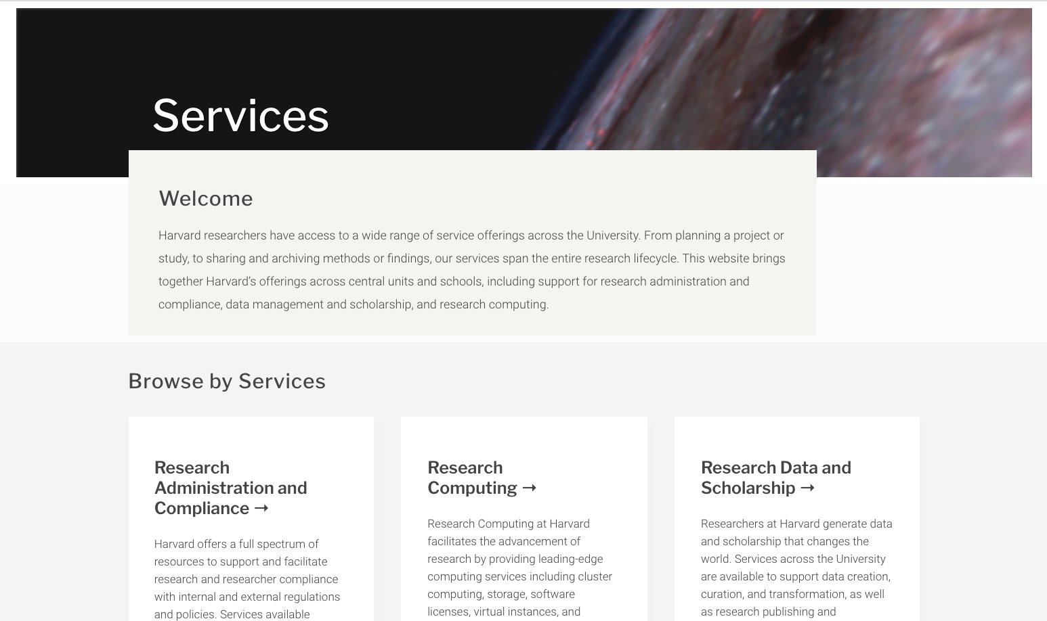
Browse service offerings by three main services

Slide 19
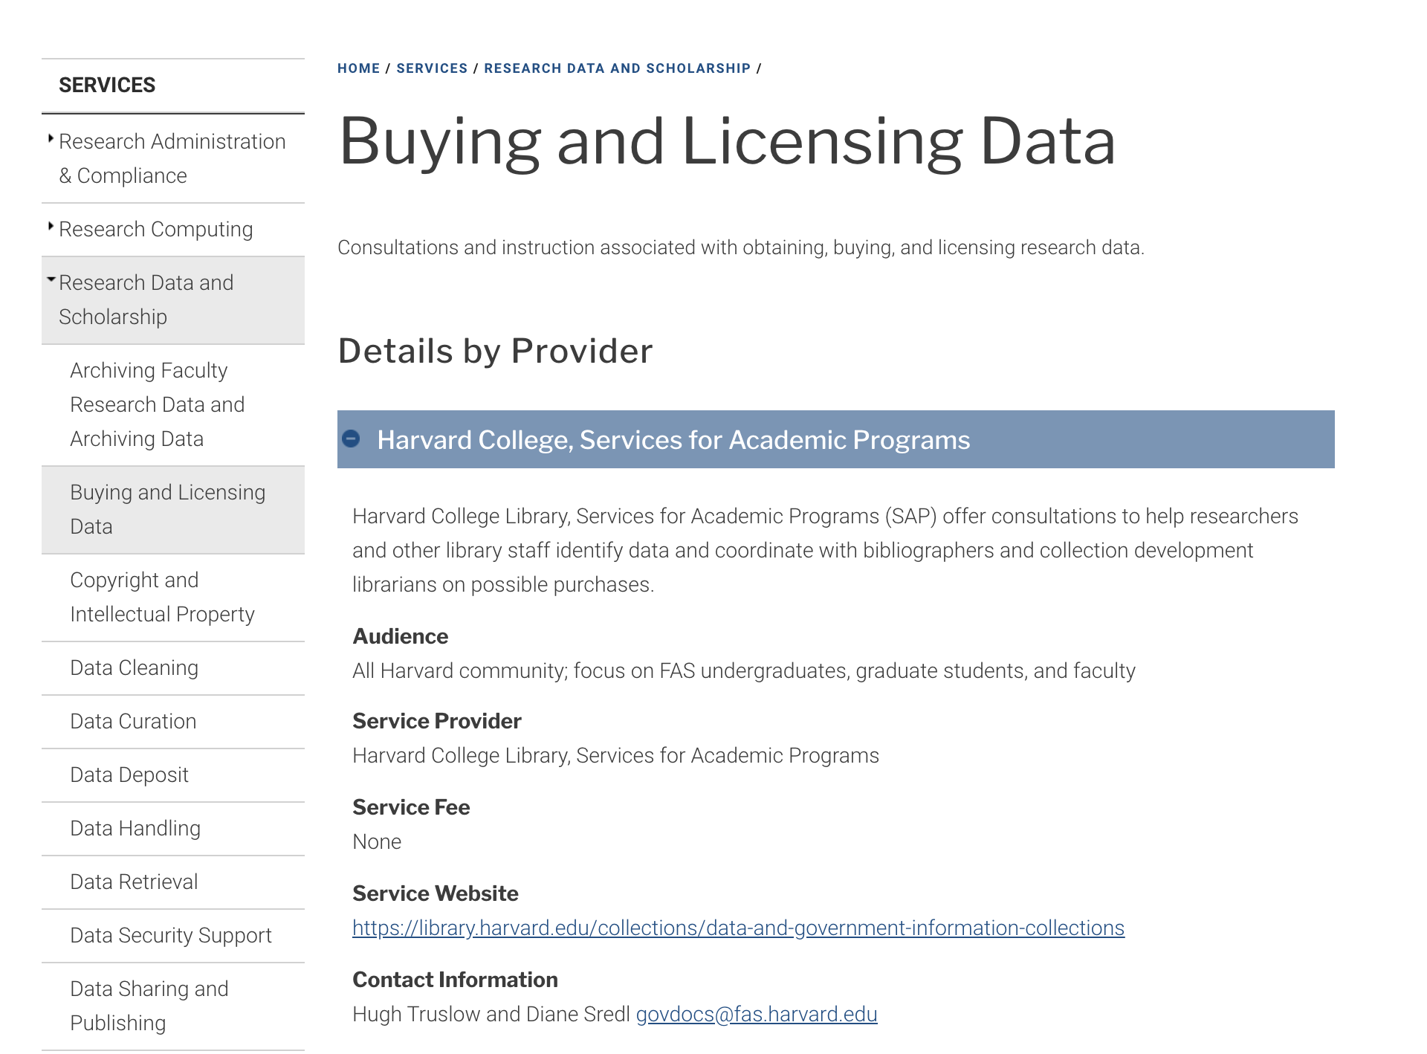
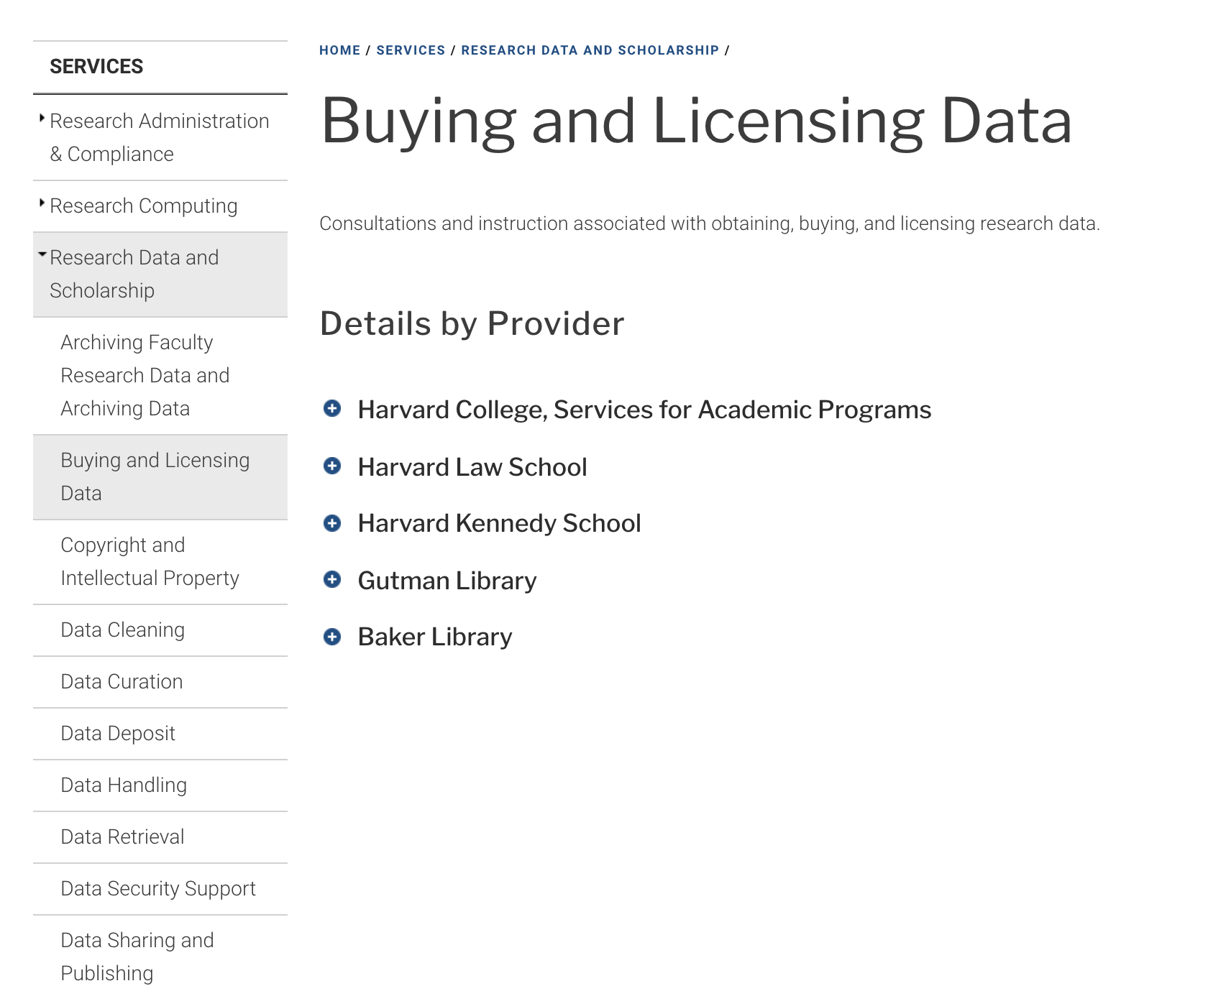
Uniformity across research support offerings
Same fields for each service offerings: Audience, Provider, Fee, Site, Contact

Slide 20
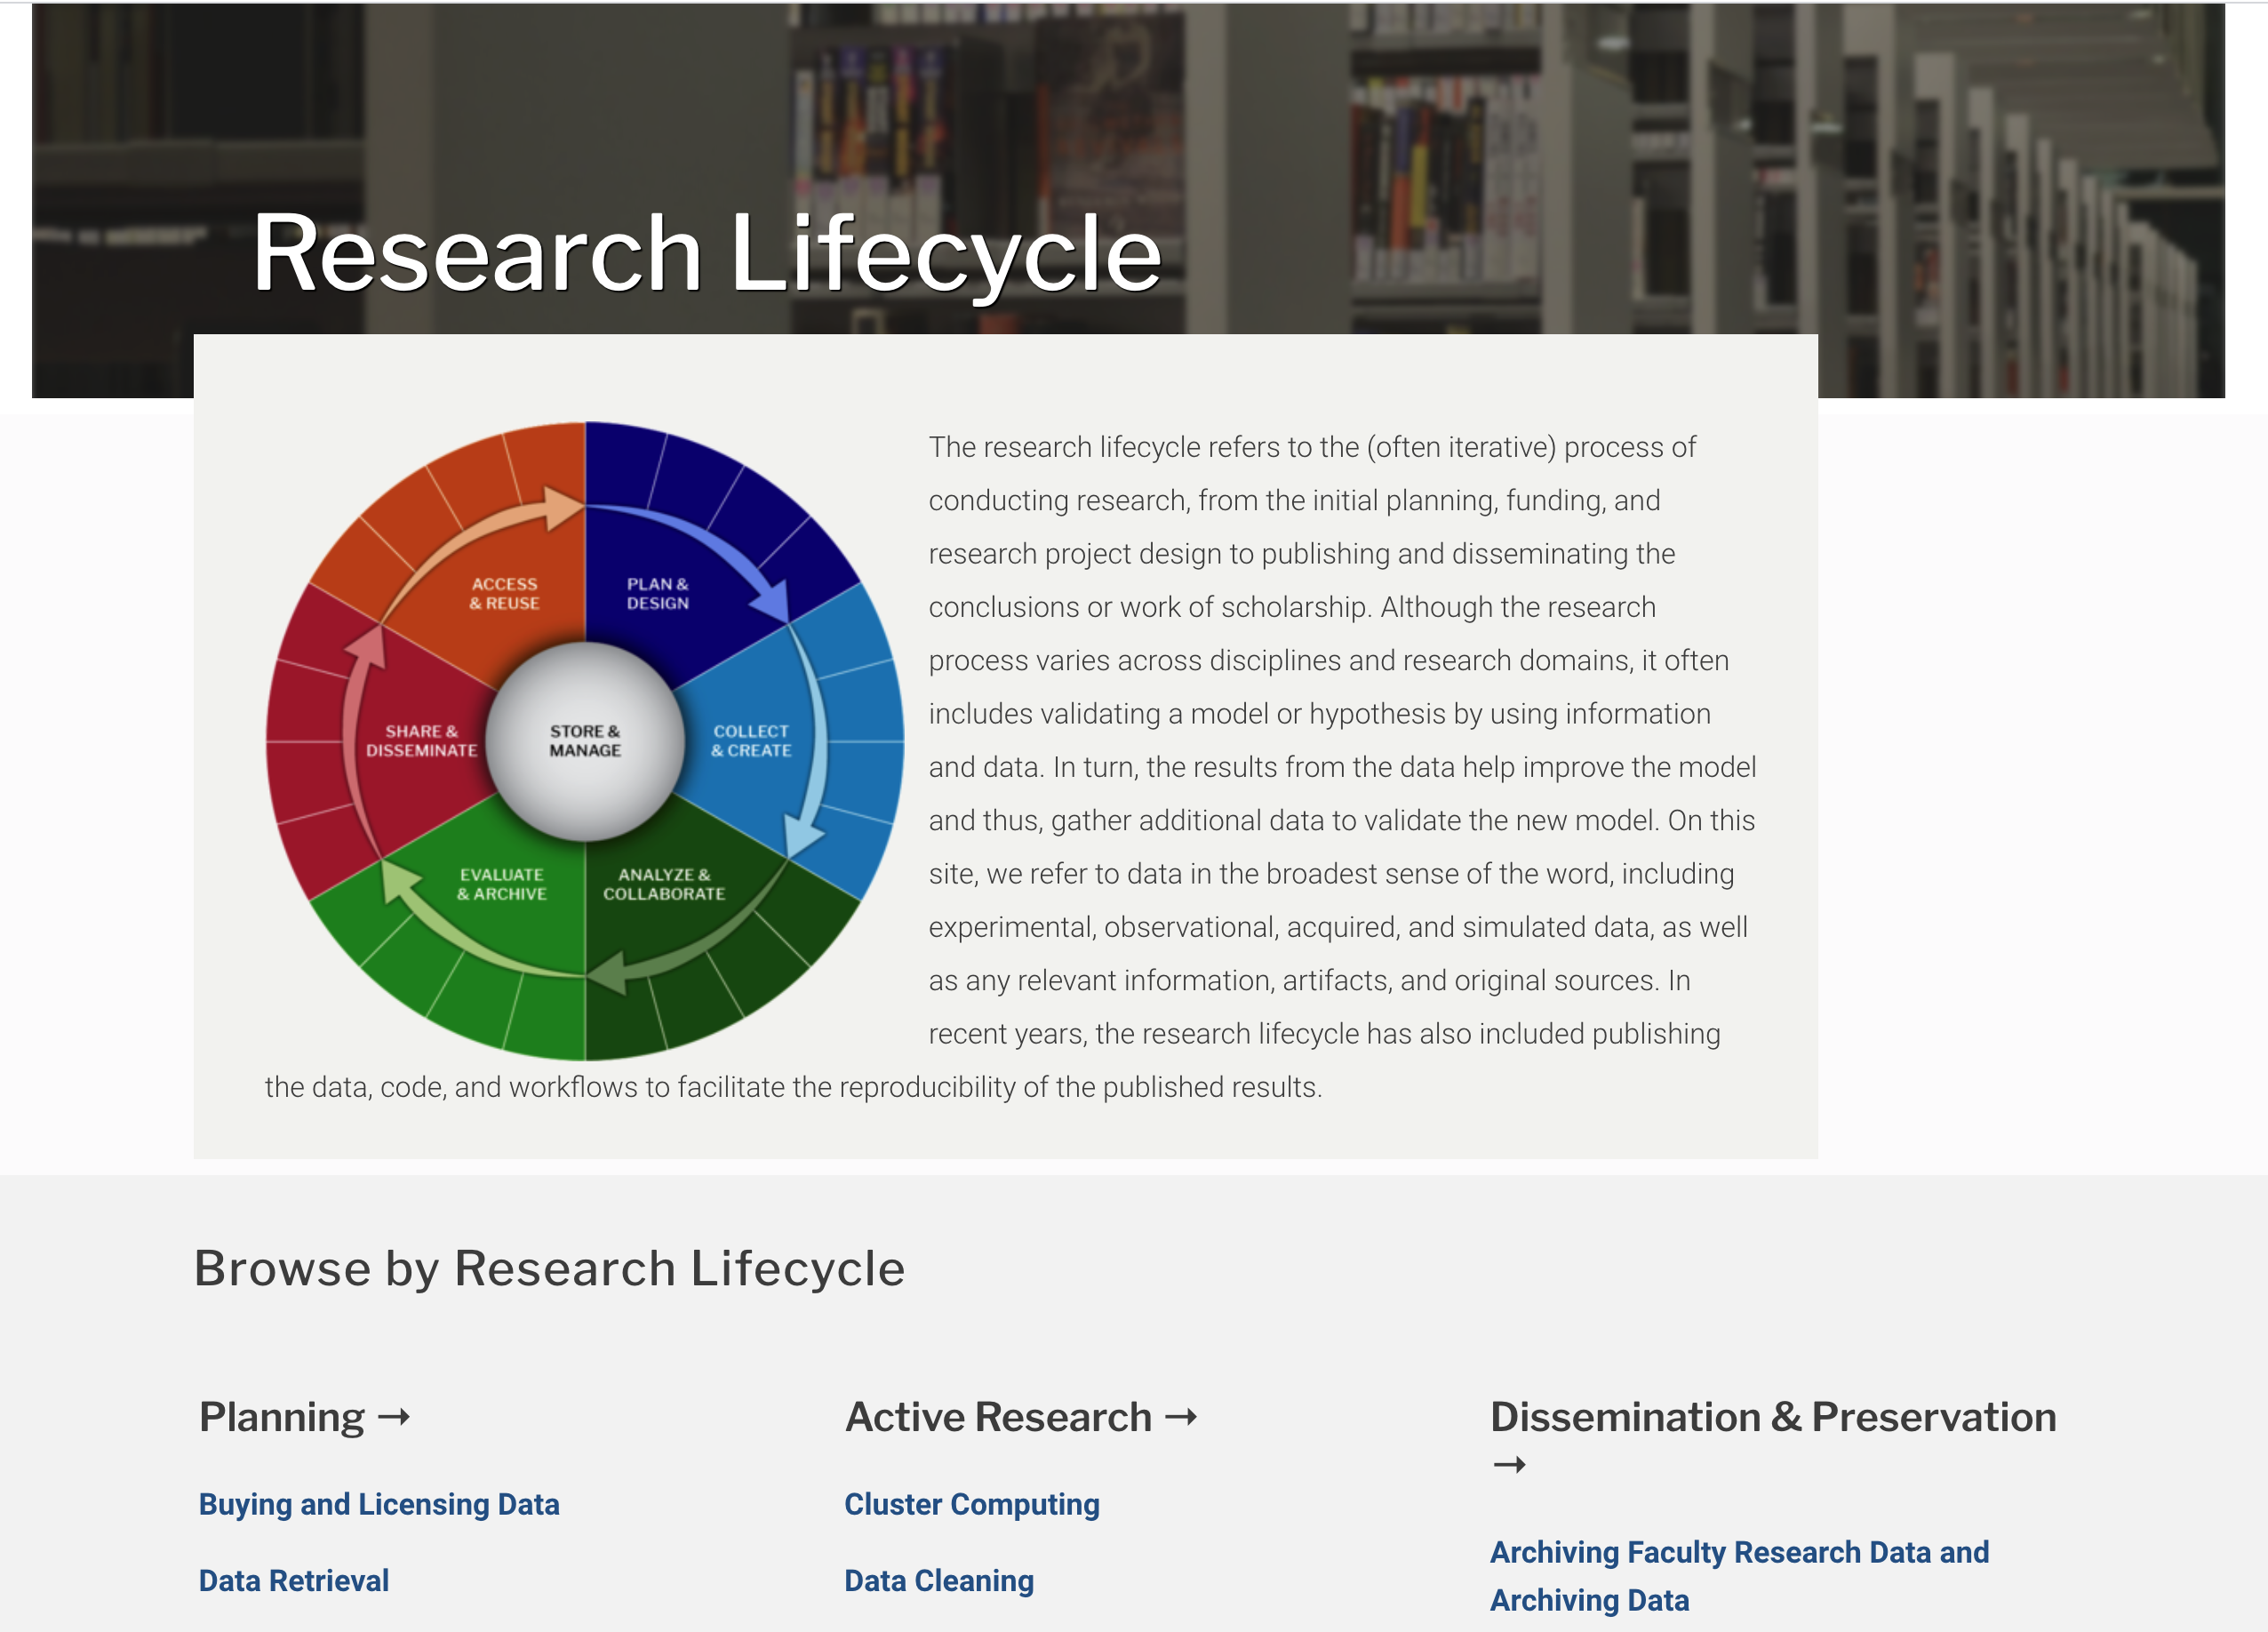
Browse services offerings by research lifecycle phases
Planning:
Access & Reuse Plan & Design Active Research:
Collect & Create Analyze & Collaborate
Dissemination & Preservation:
Evaluate & Archive Share & Disseminate

Slide 21
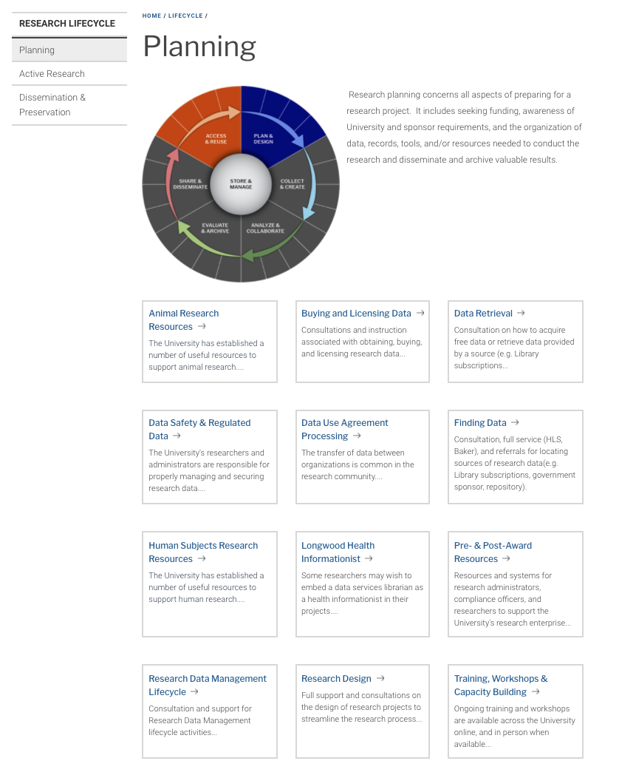
Planning: Access & Reuse Plan & Design
12 service offerings:
Buying and Licensing Data
Data Retrieval, Finding Data
Data Safety and Regulated Data
Data Use Agreement Processing
Human Subjects
Animal Research Resources
Pre- & Post-Award Resources
Research Data Management Lifecycle
Research Design
Training, Workshop, Capacity Building
Project Health Informationist

Slide 22
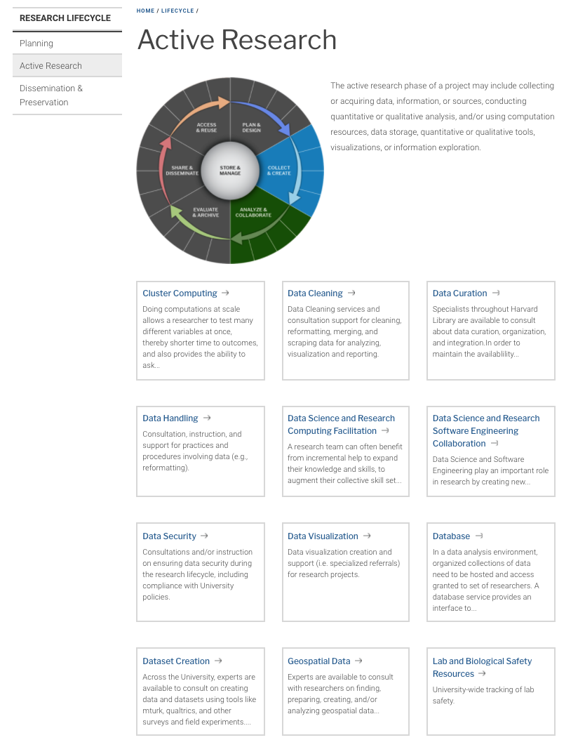
Active Research: Collect & Create Analyze & Collaborate
18 service offerings
Cluster Computing, Virtual Instances
Research Data Storage, Database, Data Security
Software and Platforms
Research Computing Consulting & Facilitation
Data Science and Research Software Engineering, Statistical Analysis, Text Analysis
Dataset Creation, Data Cleaning, Data Curation, Data Handling, Metadata creation
Data Visualization
Geospatial data
Qualitative Data Support
Lab and biological Safety

Slide 23
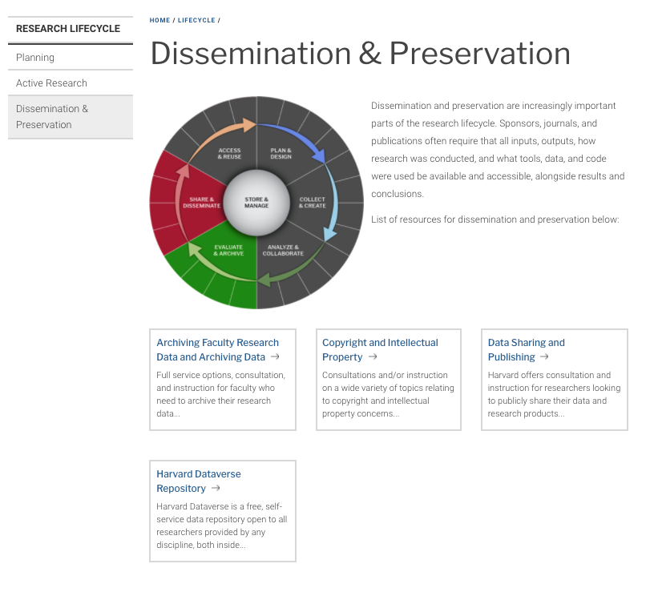
Dissemination & Preservation: Evaluate & Archive Share & Disseminate
4 service offerings:
Copyright and Intellectual Property
Archiving data
Data Sharing and Publishing
Harvard Dataverse Repository

Slide 24
Services | Planning | Active Research | Dissemination & Preservation
Research Administration & Compliance | Data Safety and Regulated Data Data Use Agreement Processing Human Subjects Animal Research Resources Pre- & Post-Award Resources | Lab and Biological Safety Data Security
Research Computing |  | Cluster Computing Virtual Instances Research Data Storage, Database Research Computing Consulting & Facilitation Data Science and Research Software Engineering
Research Data & Scholarship | Buying and Licensing Data Data Retrieval Finding Data RDM Lifecycle Research Design Training, Workshop, Capacity Building Project Health Informationist | Text Analysis Data Cleaning, Data Handling Dataset Creation, Metadata creation, Data Curation, Data Visualization Geospatial data Qualitative Data Software and Platforms | Copyright and Intellectual Property Archiving data Data Sharing and Publishing Harvard Dataverse Repository

Slide 25
What’s Next

Slide 26
What we are learning
Increase in data science and data-centric research is transforming the way we need to provide research services to our universities
Data science and data handling are becoming an integrated part of the education
Research support services are often distributed across schools, centers and facilities, but they might be duplicative or depend on each other
Some services benefit from being centralized, but others work better close to subject expertise
Collaboration and communication are key and must be constant

Slide 27
Towards an integrated solution
Research data, computing, and compliance services should be integrated to each other and to the research work
We need integrated technology and research tools to support the services
Whenever possible, we should automate and streamline the steps. For example: machine-actionable Data Management Plans and Data Use Agreements; Electronic Lab Notebooks, Computational Notebooks, and Workflows integrated with repositories
A Harvard Data Commons can be part of the solution by providing the interoperability and tooling needed and connecting the services with the technology.

Slide 28
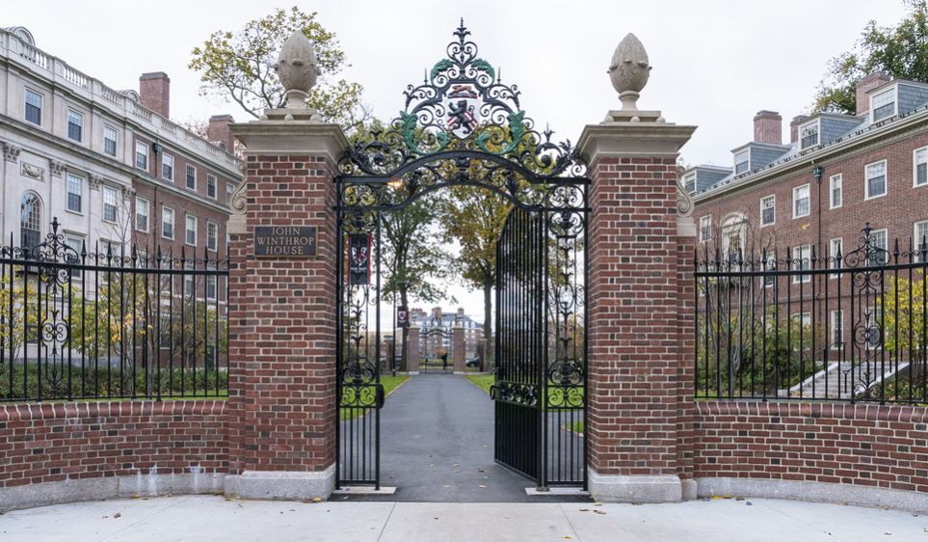
Thank you
Mercè Crosas, Ph.D., Harvard University
scholar.harvard.edu/mercecrosas @mercecrosas

